Slide 1
JAVA, JEE Training Introduction to Web
Harinath Mallepally
harinath@careerscale.in
http://careerscale.in
Notes:
IMPORTANT – PLEASE READ.
Use this template to create your online courses. Change the template as you see fit, including the logo, images and copyright information. Add your speaker's notes to the Notes section of the PowerPoint (e.g. THIS SECTION) and then submit it to Dual Code's PowerFlash service.
Your PowerPoint will be converted to a Flash-based eLearning module or presentation. A professional voice-over artist will read you speaker’s notes and incorporate the resulting audio files in the Flash course. You will also have the option to save the course to a standard (Flash + HTML) format or SCORM compliant package so you can deploy it in your Learning Management System of choice.
Try it for FREE. Visit http://www.dualcode.com/elearning/powerflash.htm for more details.

Slide 2
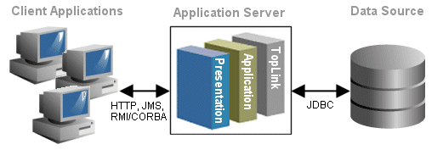

Architecture of Web Applications
Three layer architecture
Client Application
Client application provides interfaces to interact with users. For web applications, client applications are browsers.
The contents displayed on the client application are obtained from the application server.
After receiving inputs from users, the client application submits the user inputs to the application server.
Users
*

Slide 3
Architecture of Web Applications
Application Server
Application server is a container which allow server applications to run within it.
Application server handles the requests from the client application and pass them to the server application.
These requests are generally sent through HTTP (Hypertext Transfer Protocol), which specifies a set of methods and headers that allow clients and servers to interact and exchange information.
Server application then processes the requests and sends the responses back to the client application.
Server application can also accesses database via JDBC, if database manipulations are needed.
Database
Many software can be used to store and manage data (e.g., MS SQL, Oracle, and MySql)
*

Slide 4
Web Server
To build a web application, we need a server which is able to deal with
Http requests
Server applications
Therefore, web server is chosen based on the programming languages by which the server application is coded.
Apache Tomcat
Apache Tomcat is an open source software implementation of the Java Servlet and JavaServer Pages (JSP) technologies.
http://tomcat.apache.org/download-70.cgi
Prerequisite – JDK 1.6 and above. Prefer java 7
JDK 6 Update 17 with Java EE
http://www.oracle.com/technetwork/java/javase/downloads/jdk7-downloads-1880260.html
IIS – for ASP .Net
*

Slide 5
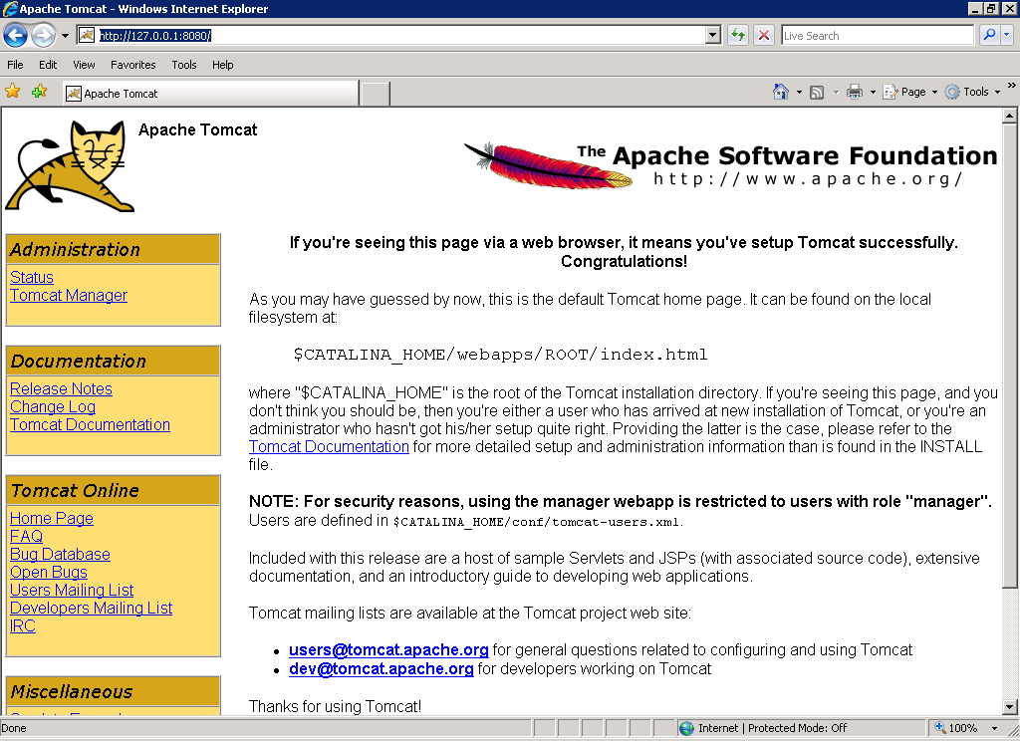
Apache Tomcat
Test
http://127.0.0.1:8080
*

Slide 6
Apache Tomcat
File Structure
TomcatRoot
C:\Program Files\Apache Software Foundation\Tomcat 6.0 (default)
TomcatRoot/bin
Executable files
Tomcat6.exe – command line mode; Tomcat6w.exe – service mode
TomcatRoot/conf - Configuration files of Tomcat
TomcatRoot/lib
Libraries/APIs required to run Tomcat
TomcatRoot/logs - Log files
TomcatRoot/webapps (http://localhost:8080/)
Application root – Put your web applications under this folder
TomcatRoot/work
Used to store compiled JSP files (cache).
*

Slide 7
Web Application
Using eclipse as an example
*

Slide 8
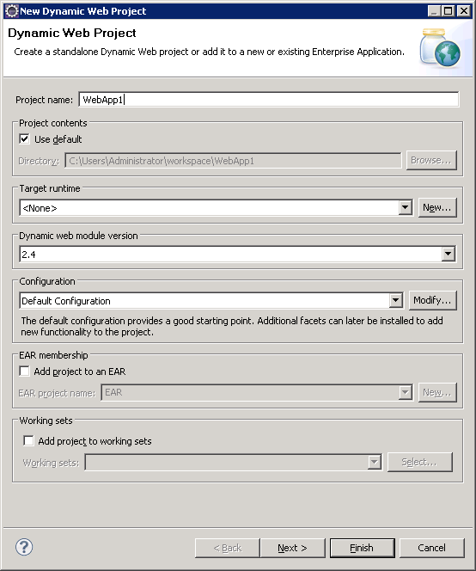
Create A Web Application Project
Create A Web Application
Eclipse -> File -> New -> Dynamic Web Project
Put in the project name (ex. WebApp1) -> Next
http://localhost:8080/WebApp1/
*

Slide 9
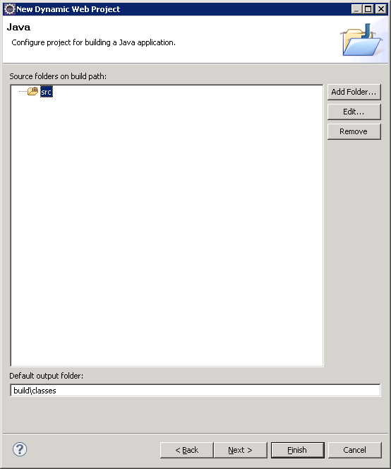
Create A Web Application Project
src
The source code folder
build\classes
The folder for compiled class files
Click Next
*

Slide 10
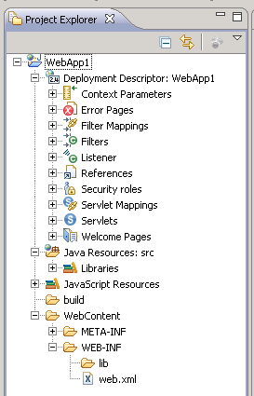
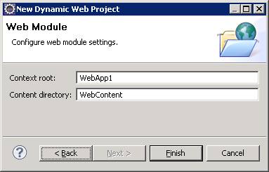
Create A Web Application Project
Click finish
*

Slide 11
Web Application Project – File Structure
Deployment Description
Summarizes current status and setting of the project
Java Resource: src
The folder for java source codes (such as .java files)
JavaScript Resources
Built-in JavaScript libraries
Build
The fold of compiled class files (*.class) and imported APIs
WebContent (Root Folder of the application)
http://localhost:8080/WebAppName/
All application contents should be put under this folder.
WEB-INF (the system folder of a web application) contains
Configuration files (WEB-INF/web.xml)
Complied java codes (WEB-INF/classes)
Third-party libraries/APIs (WEB-INF/lib)
*

Slide 12
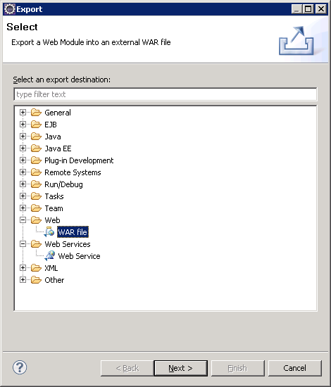
Deploy A Web Application Project
To deploy a web application, we first package the web application into a WAR file.
Deploy
Right-click on the project -> Export
Choose “WAR file” -> click next
*

Slide 13
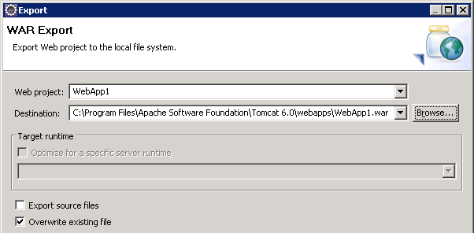

Deploy A Web Application Project
Specify the output location and click finish.
Deploy
Copy the “WAR file” to the AppRoot of the TomCat Server
C:\Program Files\Apache Software Foundation\Tomcat 6.0\webapps by default
Delete the existing project folder
Restart Tomcat
*

Slide 14
HTTP Request
Method
URL
Protocol Version
GET /index.html HTTP/1.1
Host: www.example.com
User-Agent: Mozilla/5.0
Accept: text/html, */*
Accept-Language: en-us
Accept-Charset: ISO-8859-1,utf-8
Connection: keep-alive
blank line
Headers
Body (optional)
Introduction to web programming –Harinath Mallepally
Slide *

Slide 15
HTTP Response
Version
Status
Status Message
HTTP/1.1 200 OK
Date: Thu, 24 Jul 2008 17:36:27 GMT
Server: Apache-Coyote/1.1
Content-Type: text/html;charset=UTF-8
Content-Length: 1846
blank line
<html>
...
</html>
Headers
Body
CS 142 Lecture Notes: HTTP
Slide *

Slide 16
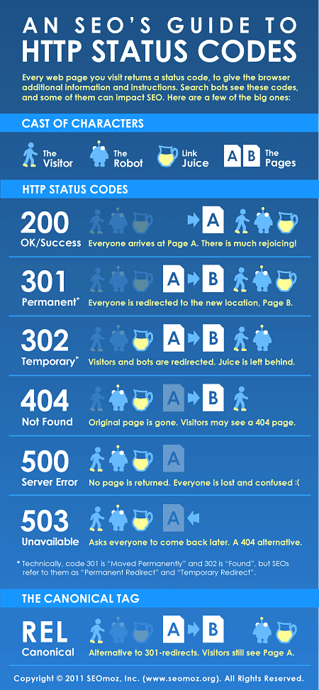
http://moz.com/learn/seo/http-status-codes

Slide 17
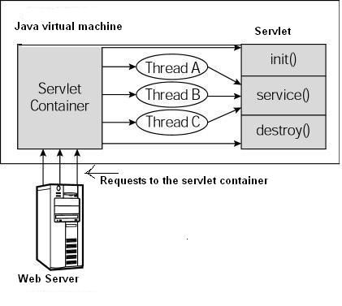

Slide 18
Servlets
ServletConfig
ServletContext
RequestDispatcher
Forward
Response.Redirect
Session

Slide 19


Slide 20

MODEL VIEW CONTROLLER - MVC

Slide 21
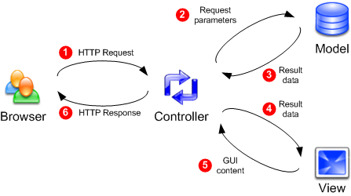

Slide 22
Firefox plugins/add ons
https://addons.mozilla.org/en-US/firefox/addon/live-http-headers/
https://addons.mozilla.org/en-US/firefox/addon/tamper-data/
https://addons.mozilla.org/En-us/firefox/addon/firebug/
CS 142 Lecture Notes: HTTP
Slide *

Slide 23
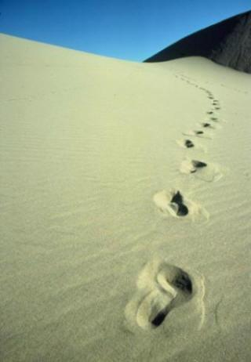
Questions?
Let us begin!

